Slide 1
2015/2016 DROUGHT RELIEF SCHEME ON INPUTS 26 NOVEMBER 2015

Slide 2
PROPOSED RELIEF SCHEME
Drought Relief in KZN for 2015/2016
Consider only the declared areas of KZN
The non declared areas
UGU - Ezingolweni
UMGUNGUNDLOVU - Impendle, - umgeni, - umzinduze
UTHUKELA - okhalamba
UTHUNGULU - mthonjaneni
HARRY GWALA - ingwe

Slide 3
PROPOSED RELIEF SCHEME
Subsidize inputs (Discount on purchases)
First come first serve principle
One stop service (One outlet link to a LM – Pay & Collect same day)
One purchase opportunity per farmer
Farmer to collect inputs

Slide 4
SUPPLIER
The service will be provided over a period of three months subject to a limited budget (SCM).
The contracted suppliers will provide inputs to affected farmers whilst compiling a portfolio of documentation on farmers to be submitted to DARD for payment (SCM).
The suppliers have been identified using predetermined criteria, viz.; (no. of outlets; Financial Capacity - carry substantial credit until payment; administrative capacity; able to handle bulk/ volume of inputs in a short time).

Slide 5
SUPPLIER
Suppliers will be allocated a budget depending the number of outlets it serves.
A supplier outlet will be identified for each Local Municipality
Supplier outlets will receive a budget allocation based on the local municipality it serves
The budget is calculated on the animal numbers in the local municipality.

Slide 6
INPUTS
The inputs considered will be subdivided into two categories, viz.; those for livestock and those for water supply.
The inputs are as follows:
Livestock – Registered Licks, Registered Ruminant Pellets, Multi-vitamins, Dip, salt, Registered meal
Water – water harvesting (Jojo tanks, 2.4m through, 6m gutter)
(NB - Transport will be farmers own cost)

Slide 7
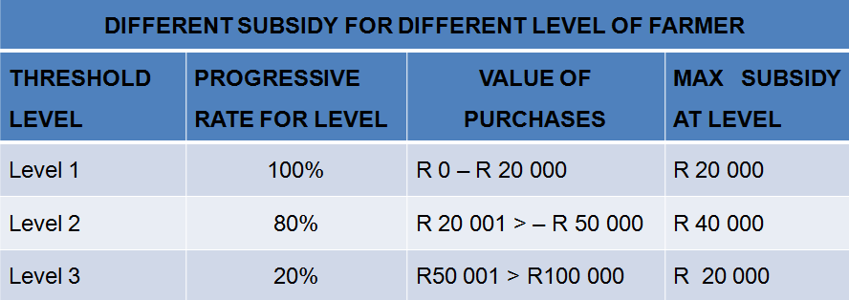
QUALIFYING FOR A SUBSIDY
A capped subsidy will be provided which differ for different categories of farmers.
The farmer will only qualify for the subsidy once he has made a purchase.
SUBSIDY (Total amount for commodities procured – VAT Included)

Slide 8
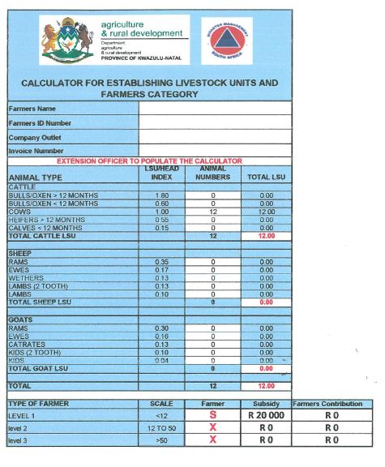
QUALIFYING FOR A SUBSIDY
The extension officer will populate the calculator
He/she will be able to indicate to the farmer what subsidy he can get and what own contribution he must make

Slide 9
QUALIFYING FOR A SUBSIDY
A farmer does not qualify for a subsidy if he
does not register (complete an assessment form)
does not buy from the supplier for a subsidy,
does not resides in the demarcated area and
Did not make a purchase of inputs from the supplied list of inputs.

Slide 10
QUALIFYING FOR A SUBSIDY
In addition a farmer will be required to supply the following information at registration, i.e.
Farmer ID
Farmer Name
Farm/Ward Name
Local Municipality
District Municipality
Livestock numbers(beef, goats, sheep, etc.)

Slide 11
Proof of Status
Farmer must reside in the area (FICA – Letter proof address, Councillors letter)
Farmer must be a livestock farmer (Copy of a brand mark certificate or application)
Farmer must be a South African citizen (copy of an identification certificate/book)
Farmer to Sign (or thumb print) and date the form (No crosses)

Slide 12
EXTENSION SUPPORT
Registration process to commence on placement of advert.(30Th November 2015)
Registration to be done at the designated company branch for the local district (ARDM unit to provide list)
The extension officer to be present at the designated branch from Monday to Friday during normal business hours up to the 28th February 2016 (Excluding public holidays and weekends)

Slide 13
EXTENSION SUPPORT
The Extension officers to inform the farmers on the scheme principals
Once off subsidy
No transport included
Subsidy will only come into effect on the procurement of inputs
Subsidy will be deducted off the company account (invoice) and will be claimed from DARD by the Company

Slide 14
EXTENSION SUPPORT
Extension officer to register the farmers on the electronic registration format (populate).
Extension officer must print the form (below) for the farmer as well as Company Rep to sign and sign it himself.
Farmers who cannot write, must sign with a thumb
The extension officers to copy the form two fold (Farmers copy, Company copy) - Originals to be sent to DARD ARDM.
The extension officer to attach relevant documents to registration form and forward to the company.

Slide 15
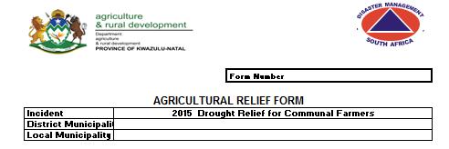
Relief form
The extension officer must make sure that the first part of the form is completed before copies are made.
Each farmer must complete a relief form
After the form is completed by the farmer the extension officer must make sure that
The personal detail is correct
all the required documentation is attached to the form
That the form is signed by all the parties
A form number must be entered, and captured when populating the database.

Slide 16
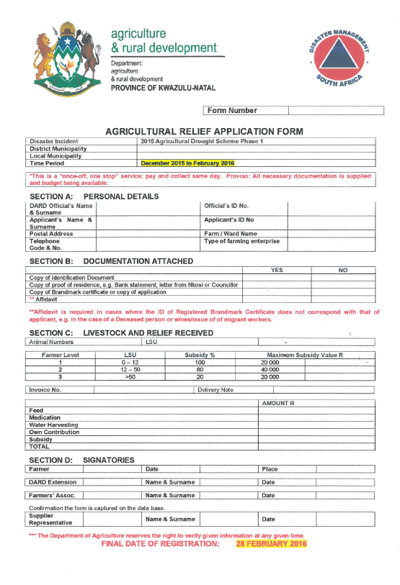
Company Rep. must sign that an order has been placed.

Slide 17
Supplier register
This register should be populated when the input is collected.
This is to keep record of the quantity of inputs collected and to make sure that it is captured correctly.
The register , assessment form and the required documentation must be sent back to ARDM for reconciliation.

Slide 18
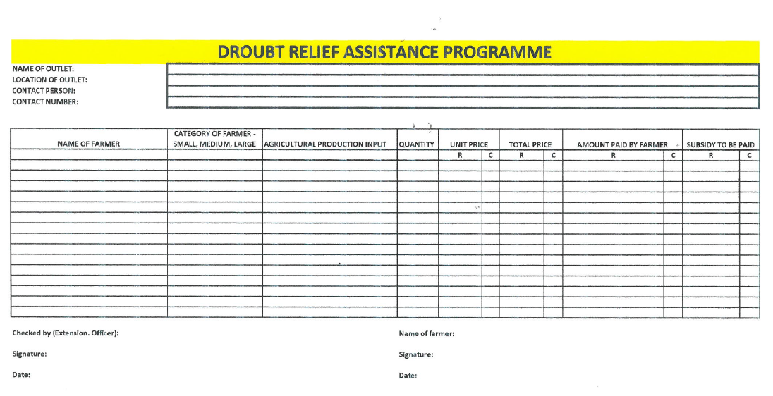

Slide 19
EXTENSION SUPPORT
The Extension Officer to verify list with company on a weekly basis
The Company rep to forward a list per company branch to the DD’s who will batch it and forward it to ARDM
REGISTRATIONS MUST NOT TO EXCEED THE COMPANY AND BRANCH BUDGET

Slide 20
Data base
All the information on the relief form must be captured onto the excel data base.
This data base will be used
As a control mechanism
To reconcile the feed distributed
To check for any duplication of information
and to compile reports.

Slide 21
Conclusion
Control is important to the success of the scheme.
The following should be returned to ARDM office:
Suppliers register with attached delivery notes
Relief forms with the attached documentation
Copy of ID document
Copy of Brandmark certificate
Copy of proof of residence
Affidavit
Electronic Database

